Slide 1
Setter Injection with Collection(List)
We can inject collection values by setter method in spring framework.
We can use three elements inside the property element. It can be:
list
set
map

Slide 2
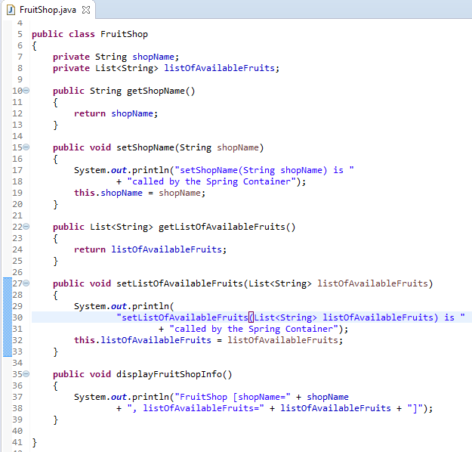
Setter Injection with Collection(List)

Slide 3
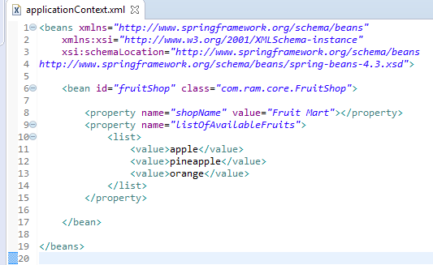
Setter Injection with Collection(List)
We are providing the information into the bean by applicationContext.xml file.
The property element invokes the setter method.
The list element is used here to define the list.

Slide 4
Setter Injection with Collection(List)
FruitShop
What object to instantiate?
What object to configure and how to configure?
The Spring Container
(ApplicationContext)
applicationContext.xml
FruitShop
Object
shopName=Fruit Mart
listOfAvailableFruits=
[apple, pineapple, orange]
Create the FruitShop object.
Configure the FruitShop object.
Manage FruitShop object complete life cycle from creation till destruction.

Slide 5
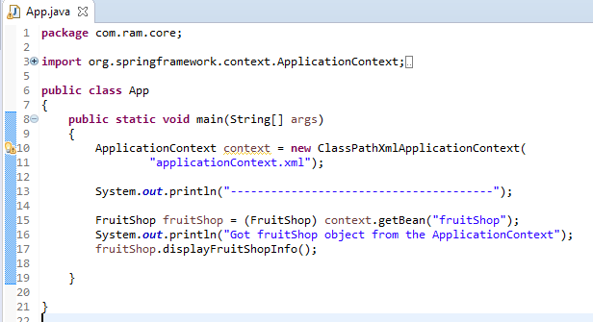
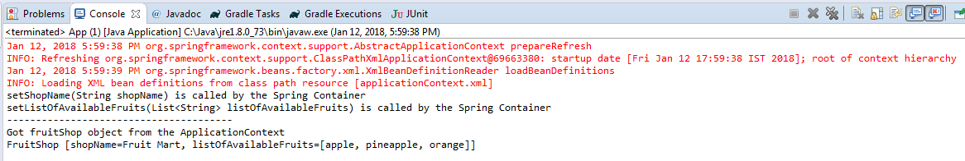
Setter Injection with Collection(List)

